Slide 1
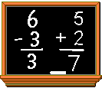
Welcome to Curriculum Night!

Slide 2
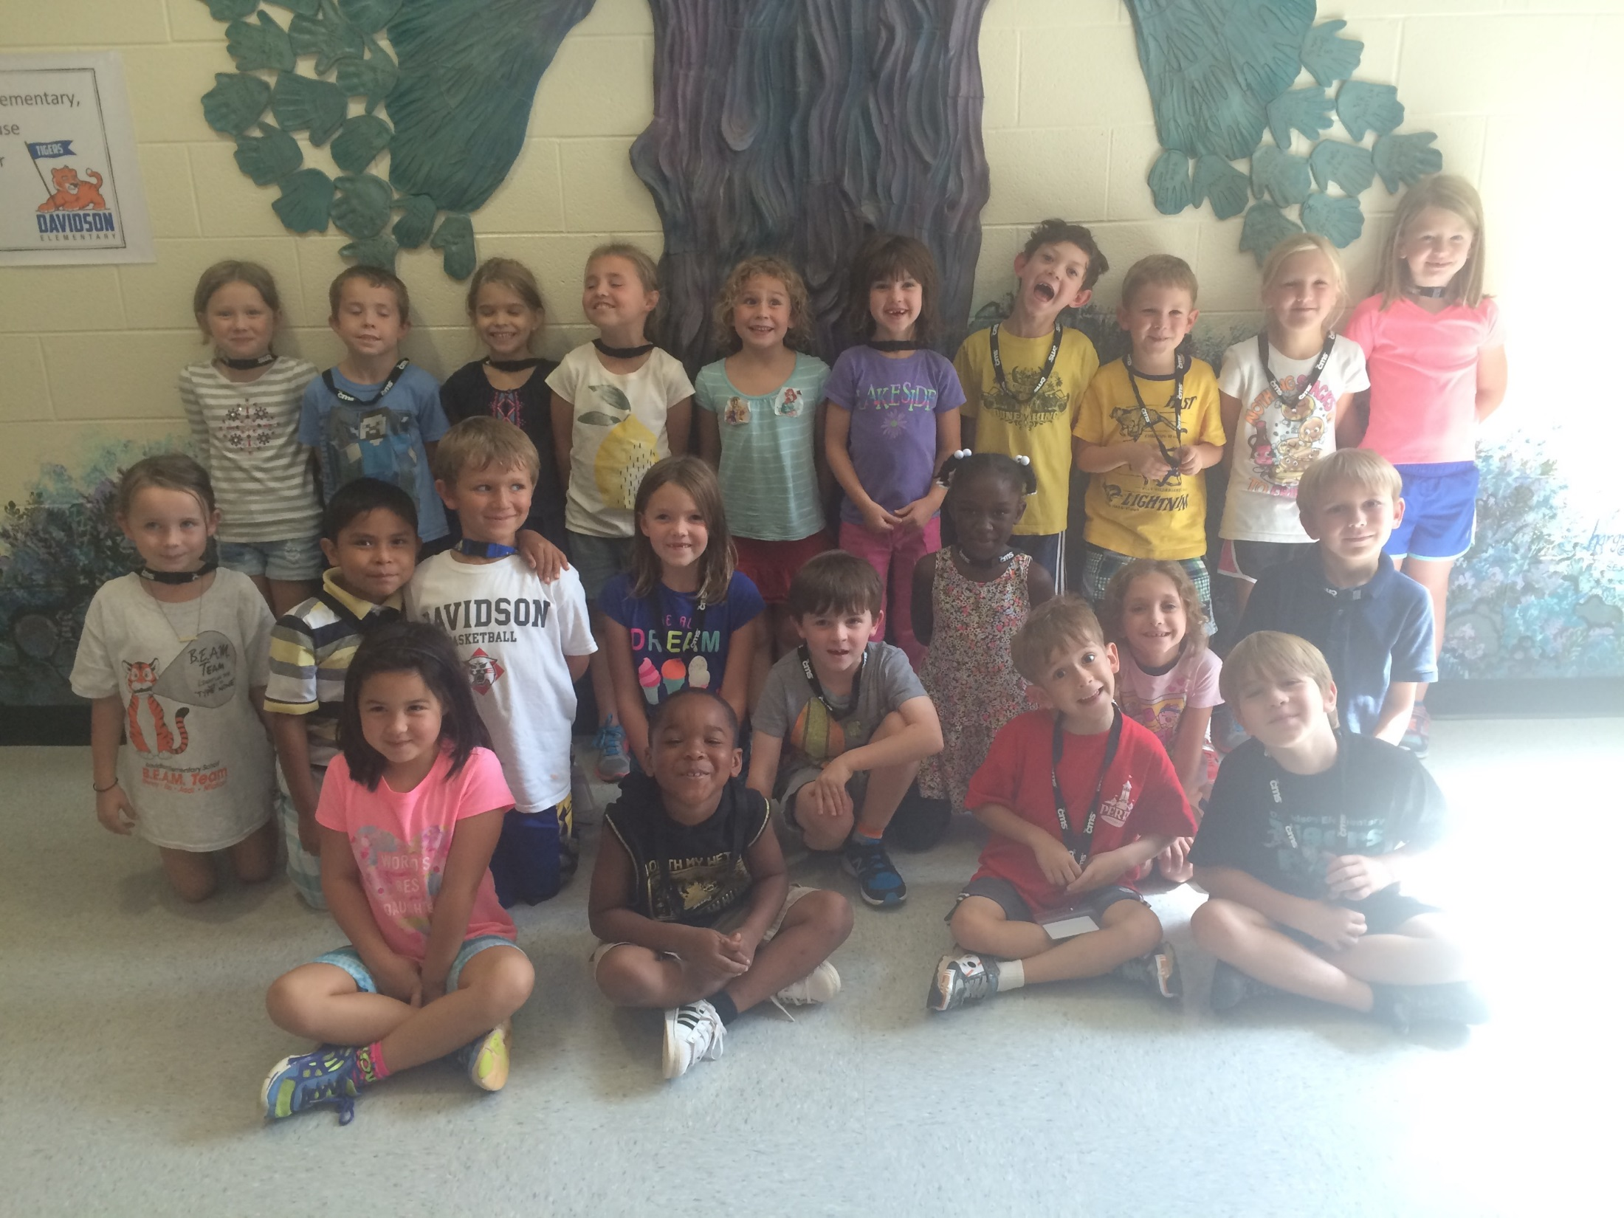

Slide 3
Curriculum Night Agenda
Tuesday, September 20, 2016
CONFERENCE SCHEDULE!
Goals for this year
A Day in the Life of Your First Grader
Homework
Assessments
Behavior Management
Communication
Reminders and bits of important information
Questions??
“A Special Note to my Star”

Slide 4
Upcoming Meeting:
Wednesday, November 9, 2016
5:00-5:30
Short informational meeting on how to ensure your child’s success with Reading 3D and improved reading comprehension.

Slide 5
Goals for this year
My goals are:
To help your children learn and succeed to their fullest potential
To have meaningful and positive relationships with your children
To have a fun, yet educational year! ☺

Slide 6
A Day in the Life of Your First Grader
8:15-8:45 Daily Preparation/Remediation/Exploration/Math Games
8:45-9:00 Announcements/Morning Meeting/ Calendar
9:00-9:30 Literacy Team Time
9:30-10:15 Reading Workshop
9:30 - 9:45 Mini Lesson
9:45 - 10:15 Guided Group/ Independent Leveled Reading/Assessments
10:15-11:00 Writer’s Workshop
- 10:15 – 10:30 Mini Lesson/Grammar
11:00-11:30 Lunch
11:30-11:40 Bathroom

Slide 7
11:40-12:10 Words Their Way – Word Sorts
12:10-1:15 Math
1:15-1:45 Recess
1:50-2:40 Connect (6 day rotation –PE, Science Lab, Media, Computer Lab, Art, Music)
2:45-3:10 Making Meaning/Vocabulary (Read Aloud)
3:10-3:30 Tigers on the Prowl
***Please bring water bottle
3:30-3:40 Phonics/grammar
3:45 Dismissal
Spanish Lessons from Davidson College have started!

Slide 8
Math in 1st Grade
Work and Represent to solve problems involving addition and subtraction
Understand and apply properties of operations and the relationship between addition and subtraction (fact families)
Add and subtract within 20 (fast facts)
Extend counting sequences (1-120)
Understand place value (tens and ones)
Use place value understanding and properties of operations to add and subtract (ten more, ten less)
Measure lengths
Tell and write time (hour, half hour)
Represent and interpret data (graphing)
Reason with shapes and their attributes (2-D, 3-D)

Slide 9
Writing
Independent Reading
Balanced Literacy
Word Work
Supported Reading

Slide 10
Independent Reading
Independent Reading can include but is not limited to:
-Reader’s Workshop
-Independent Reading/Self-selected reading
-Individual & Small Group
-Conferences
Levels
First grade: Level D –Level J/K
Range in the classroom: A-M

Slide 11
Supported Reading
c can be:
Guided Reading
Oral and written comprehension
*my reading comprehension bookmark/reading log & reading a-z book
Shared Reading
Interactive Read Alouds

Slide 12
Writing
Writing can include but is not limited to:
Writer’s Workshop
Journaling and Reflections
Preparing at home for Monday weekend writing
Writer’s Journals in the content areas
* reader’s workshop, math/science, word work, writing

Slide 13
Students explore the particulars of language across multiple genres including literature, informational texts, and poetry. They investigate the meaning and structure of words, and the conventions and forms of written language through authentic text and a variety of word study strategies.
Word Work can include but is not limited to:
Words Their Way
Vocabulary Work (Available on website)
Word Work

Slide 14
Lunch
Desserts
Birthdays
Guest Lunch
Peanut-Free Table
Healthy Snacks (No Juice!)

Slide 15
Recess
Equipment from home (Nerf or soft, basketballs ok)
School rules vs. Home rules
Appropriate Dress (gym shoes)

Slide 16
D.E.S Classroom Behavior Management
Classroom
Whole class- Cotton Jar, Smarties
Small Group- Starbursts
Individual – Agenda ☺
Connect – Connect behavior will be handled by the connect teacher.

Slide 17
Homework:
Current:
Nightly reading log *Good Reader Habits – strategies
What Are the Five Domains of Reading?
How to Read with a Beginning Reader
Different Ways to Read with your child
Why Can’t we Skip Reading Tonight?
Sound it out!
Asking the Right Questions
Bookmarks (now oral comprehension)
Second Quarter:
Bookmarks (written comprehension)
Raz-Kids (excellent reading resource)
Dreambox (excellent math resource)
Compass Learning (connected to MAPS)
Vocabulary words (use in daily conversation)

Slide 18
Assessments
MAPS – Measure of Academic Progress
Three times a year (beginning, middle, end)
Used to measure growth
Assessed on computers/individualized
Reading 3D
Measures oral and written comprehension
Measures phonemic awareness
sight word knowledge
Assessed one on one (teacher/student)
TRC is individualized

Slide 19
Communication
Please feel free to email me anytime you have a question or concern
RikkiL.Mueller@cms.k12.nc.us
Or you can always send notes in your child’s communication folder
I will do the same as things arise. ☺

Slide 20
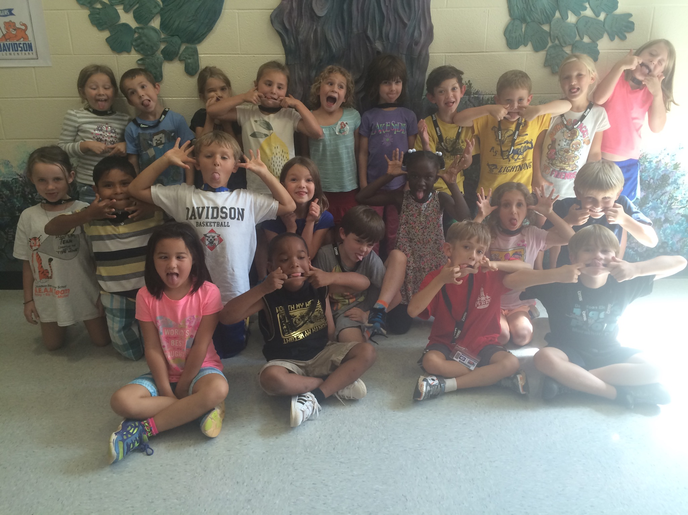
Thank you for coming!

