Slide 1
Where are we heading? Will we be ready?

Slide 2
First Grade Reading Comprehension Goals
Students are able to fluently read, comprehend, and critically think about a variety of texts.
Ask and answer questions beyond basic recall of facts.
Use evidence from the text to support answers to comprehension questions.

Slide 3
CMS & MCLASS Reading assessment
CMS uses MCLASS reading materials to determine student reading levels 3x a year.
Reading and writing skills need to be at the same level in order to help students succeed.
Students should become familiar with written responses and the academic language necessary to enhance understanding (comprehension).

Slide 4
Working together as a team
What we are doing:
Developing strategies for unknown words
Developing fluency on independent level
Determining and providing just right books
Small group reading on instructional level
Familiarizing students with evidence based terminology

Slide 5
A Variety of Materials

Slide 7
Examples of Answers
Why does Mike help his sister at the end of the story?
Use part of the story in your answer.
Minimal Understanding (1) Minimally addresses the demands of the question and uses minimal information to show information | General Understanding (2) Partially addresses the demands of the question and uses general information. | Complete Understanding (3) Addresses the demands of the question and effectively uses detailed information
He likes his sister. | Mike helped his sister because she spilled the water. | Mike was having a bad day and his sister helped him when he tripped that morning. When his sister tripped over Tiger’s bowl, Mike gave her a paper towel to help clean up the mess. Mike turned his bad day into a good day.

Slide 9
Examples of Answers
Tell why building a bridge is a good title for this book. Use details from the book in your answer.
Minimal Understanding (1) Minimally addresses the demands of the question and uses minimal information to show information. | General Understanding (2) Partially addresses the demands of the question and uses general information. | Complete Understanding (3) Addresses the demands of the question and effectively uses detailed information.
The book has a bridge. | It is a good title because it tells how to build a bridge. | Building a Bridge is a good title for this book because it explains what a bridge is and how they are built. On page 8, the author put a table in to show different types of bridges. The last 5 pages of the book show pictures and the steps for how to build a bridge.

Slide 10
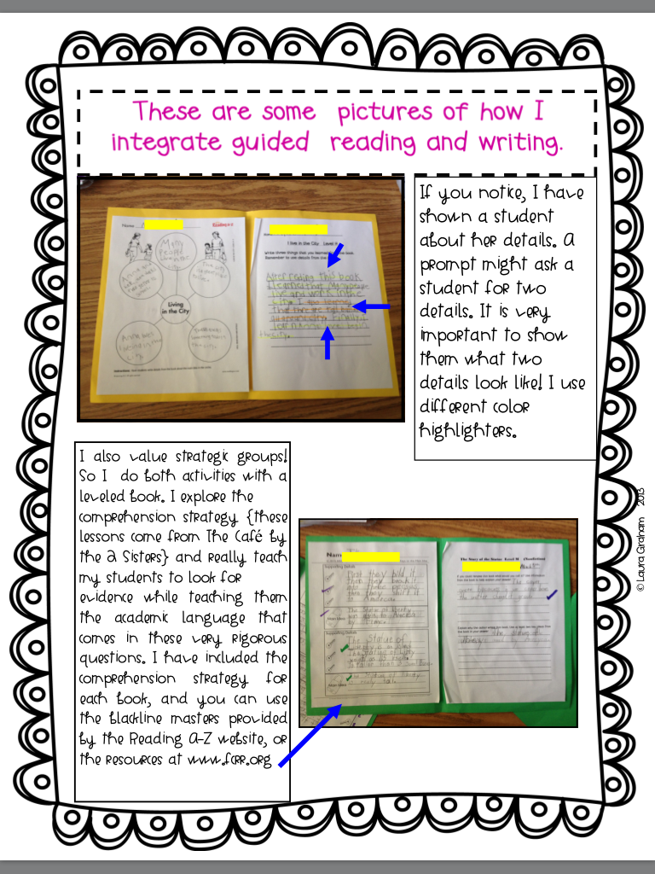

Slide 11
Working Together as a Team
What parents can do…
Listen to your child read daily
Use the bookmarks as a guide
Weekly written reading comprehension (quality handwriting, sight words highlighted, correct grammar, rephrase question in answer)
Make it a positive experience (give them choices!)

Slide 12
Working Together as a Team
What your child should do…
Select a book that interests them and bring it home
Read a variety of books
Bring the book back daily
Turn in completed homework each Friday
Communicate with parents
Understand that parents, teachers, and students are a team
Be an active participant in their own learning!

Slide 13
Homework
Homework Due Fridays
1.Daily Home Reading
Please continue to read daily with your child and note it in the Reading Log. The books your child is bringing home are “just right” books that are on his/her independent reading level.
2.Reading Comprehension
Please ask your child questions daily from the reading comprehension bookmark that go along with the books you are reading at home this week.
3.Written Reading Comprehension
Write the question (adult) and answer (child) to one question from the reading comprehension on the attached lined paper.
Written answers to comprehension bookmark questions should reflect your child’s best effort and quality handwriting.
Please have your child use the question to start the answer both orally and written.
Example: Why do you think the author wrote this book? Answer: I think the author wrote this book because …

